Slide 1

Big Data Hadoop
An Introductory Session

Slide 2
Agenda
What is Big Data?
Big Data Factors
Big Data Challenges
Approach - Vertical vs Horizontal
Distributed Computing
Apache Hadoop
Popular Use Cases
Job Roles in Hadoop

Slide 3
Big Data
A Challenge, An Opportunity.

Slide 4
Big Data! (1)
Big data is a term applied to datasets whose size is beyond the ability of commonly used software tools to capture, manage, and process the data within a tolerable elapsed time.
- Gartener
Gartner Predicts 800% data growth over next 5 years
80-90% of data produced today is unstructured

Slide 5
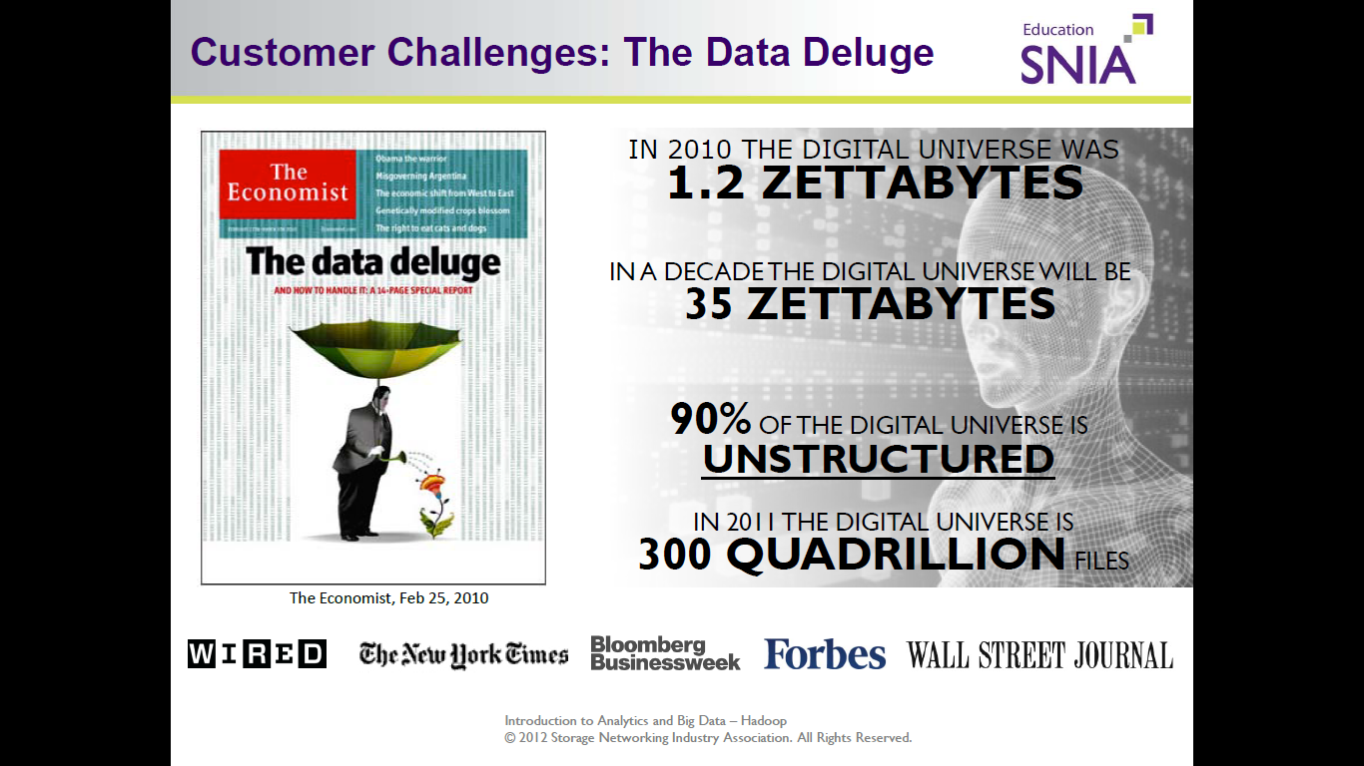
Big Data! (2)
From Data towards Big Data

Slide 6

Big Data! (3)
Data Growth Forecast
By 2009
800 000 Petabytes
gigabyte (GB) | 10⁹ | 1024MB
terabyte (TB) | 10¹² | 1024GB
petabyte (PB) | 10¹⁵ | 1024TB
exabyte (EB) | 10¹⁸ | 1024PB
zettabyte (ZB) | 10²¹ | 1024EB
yottabyte (YB) | 10²⁴ | 1024ZB
2020
35 Zettabytes
1 zettabyte = 1 099 511 627 776 GB
Source: IDC, The Digital Universe Decade – Are You Ready?, May 2010

Slide 7
Big Data Factors
3Vs

Slide 8
Big Data Factors (1)
Velocity
Data stored in Data Centers, Servers etc.
Streaming Data growing with lightening speed.
Structured, semistructured and unstructured data.
Volume
Variety

Slide 9
Big Data Challenges
Untamed potential.

Slide 10
Big Data Challenges (1)
Datawarehouse
What ?
1 - 10cr
2nd - 12 cr
3 - 15 cr
9 - 35 cr
10 - 17 cr
Sales DB
15 years
ETL
Extract
Transforms
loads
Veracity
Value
Call Center
Email
Feedbacks
Ratings
Reviews
Dark Data
Hadoop
ELT - Extract Load Transformation

Slide 11
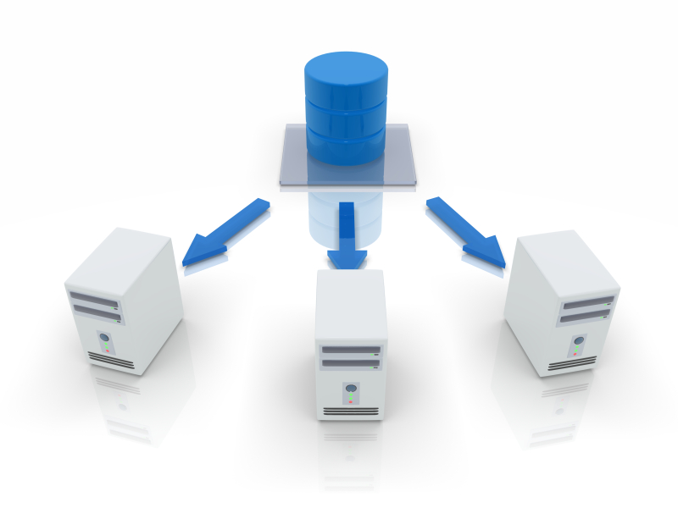

Big Data Challenges (2)
75% of current data warehouses will not scale to meet the new velocity and complexity of data demands
86% of companies cannot deliver the right information at the right time
Source: http://www.slideshare.net/cultureofperformance/gartner-idc-and-mckinsey-on-big-data

Slide 12
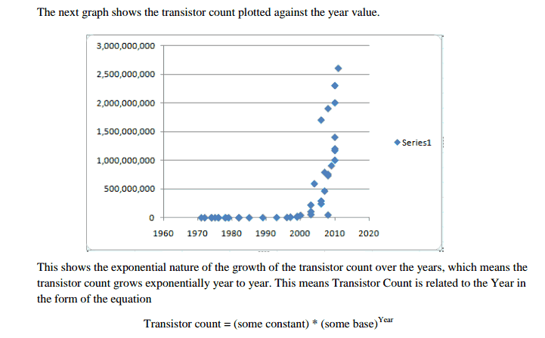
Big Data Challenges (3)
Forecast for Growth of Electronics
“ Moore's law is the observation that, over the history of computing hardware, the number of transistors on integrated circuits doubles approximately every two years. ”
..Intel co-founder Gordon E. Moore
But is this actually happening ??

Slide 13
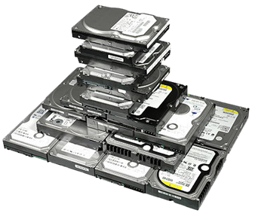
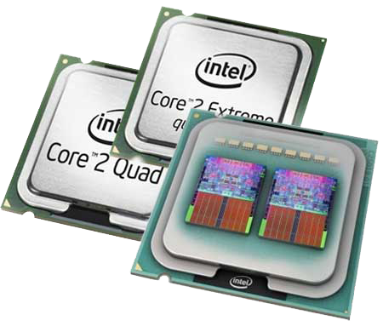
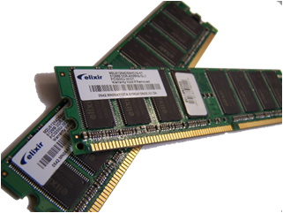

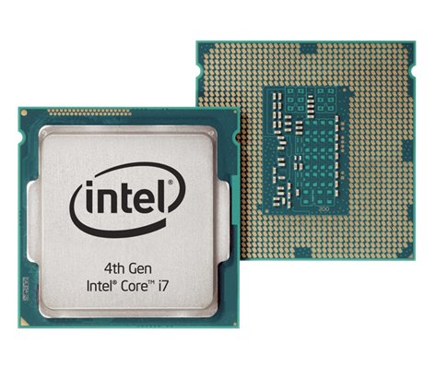
Big Data Challenges (4)
Challenges of Electronics - VLSI
Electronics has its limits – (Cannot go Beyond Nano-Tech)
If it does it , will it be cost effective ?
HDD Max Size : 6TB
RAM Max Capacity : 32GB
CPU Max Speed

Slide 14
Approach - Vertical vs Horizontal
Deriving Solutions.

Slide 15

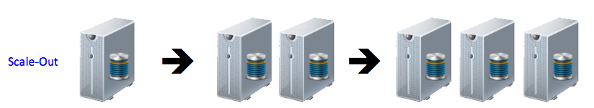


Approach - Vertical vs Horizontal
Vertical - Scale-up Parameters
Horizontal - Scale-out Parameters
Bigger Capacity Computers with Time
Expensive Hardware
Proprietary Software
Platform Lock-In
Regular Intel / AMD Hardware
Open Source Software
Platform Independence
Add Servers to increase Capacity & Performance

Slide 16

Distributed Computing (1)
Distributed computing is a field of computer science that studies distributed systems. A distributed system is a model in which components located on networked computers communicate and coordinate their actions by passing messages. The components interact with each other in order to achieve a common goal.

Slide 17
Distributed Computing (2)
If I Need to process 100TB datasets
• On 1 node:
– scanning @ 50MB/s = 23 days
• On 1000 node cluster:
– scanning @ 50MB/s = 33 min
Challenge: Hardware Problems / Process and combine data from Multiple disks

Slide 18
Apache Hadoop
One Shot Solution.

Slide 19

Apache Hadoop (1)
Apache Hadoop is an open source framework for storing, processing and analysing massive amounts of multi-structured data in a distributed environment.
Distributed Data Processing
Distribution Data Storage

Slide 20
Apache Hadoop History
2004
Nutch Distributed Filesystem (NDFS)
2005
Mapreduce
2006
From Nutch to Hadoop
2008
2003
Google Distributed File System
Google publishes GFS paper
2002
Apache Nutch
Doug Cutting
Apache Lucene
Hadoop – top level project in Apache
Hadoop broke world record to sort terabyte data

Slide 21
Apache Hadoop (2)
Architecture
Solution
Master
NameNode
Secondary NameNode
Job Tracker
Slave
DataNode
TaskTracker
Client
Data Storage
NameNode
Secondary NameNode
DataNode
Processing
Job Tracker
Task Tracker

Slide 22
Popular Use Cases
Hadoop gone wild.

Slide 23

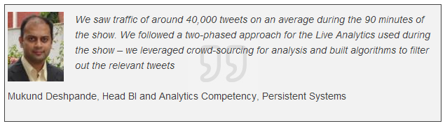
Popular Use Cases (1)
Sentiment Analysis for Amir Khan’s hosted Satyamev Jayate based on Social Data
http://gigaom.com/2012/08/11/how-indias-favorite-tv-show-uses-data-to-change-the-world/
More than 8 million people have contributed a total of more than 14 million responses to the show’s content via Facebook, web comments, text-message votes and a telephone hotline. More than 100,000 new people respond each week.
Parsing through millions of messages

Slide 24
Job Roles in Hadoop
Highest paid technology.

Slide 25
Job Roles in Hadoop
-- HADOOP ARCHITECT / CONSULTANT
Applicable For Manager’s With Around 6 Years Of Experience
-- HADOOP ADMINISTRATOR
Applicable for Linux Admin
-- HADOOP DEVELOPER
Applicable for Java / DWH/BI/DB/Now-a-Days Freshers(Certified)
-- QA’S
Applicable for Any Testing (MR Unit)
- System Testing
- Application Testing
-- MAINFRAME PROFESSIONALS
AS HADOOP ENTERS MAINFRAME AREA

Slide 26
Thank You!
9762203269
kushal@indeedinspiring.com

